Slide 1
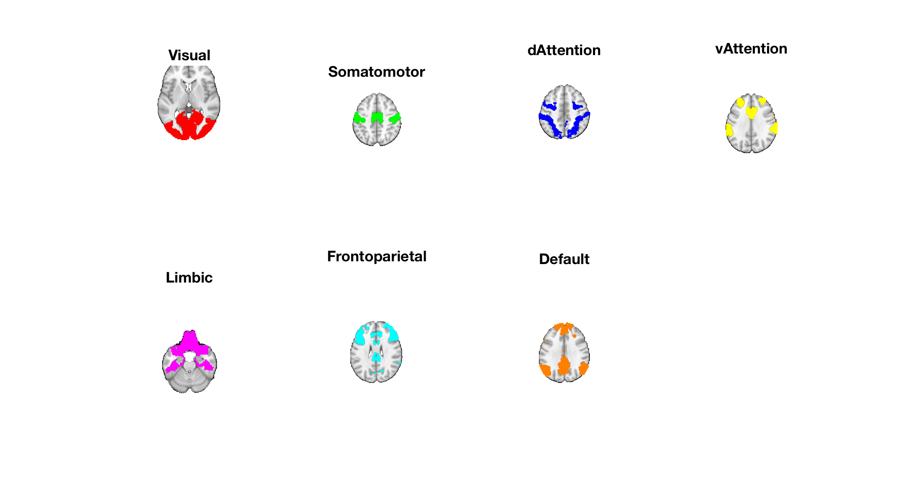
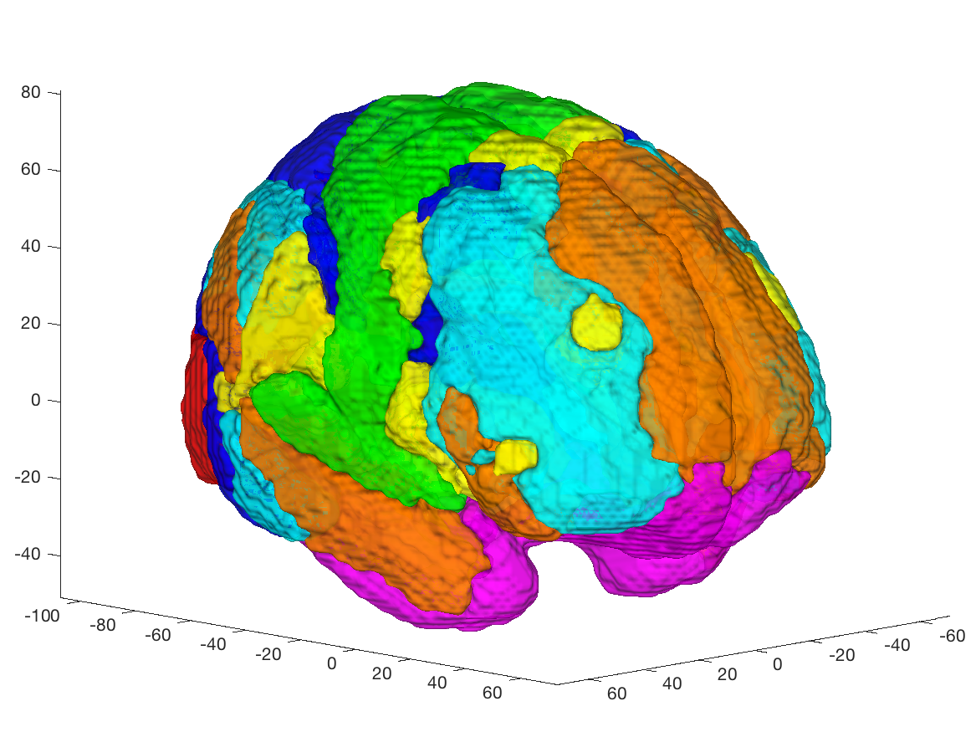
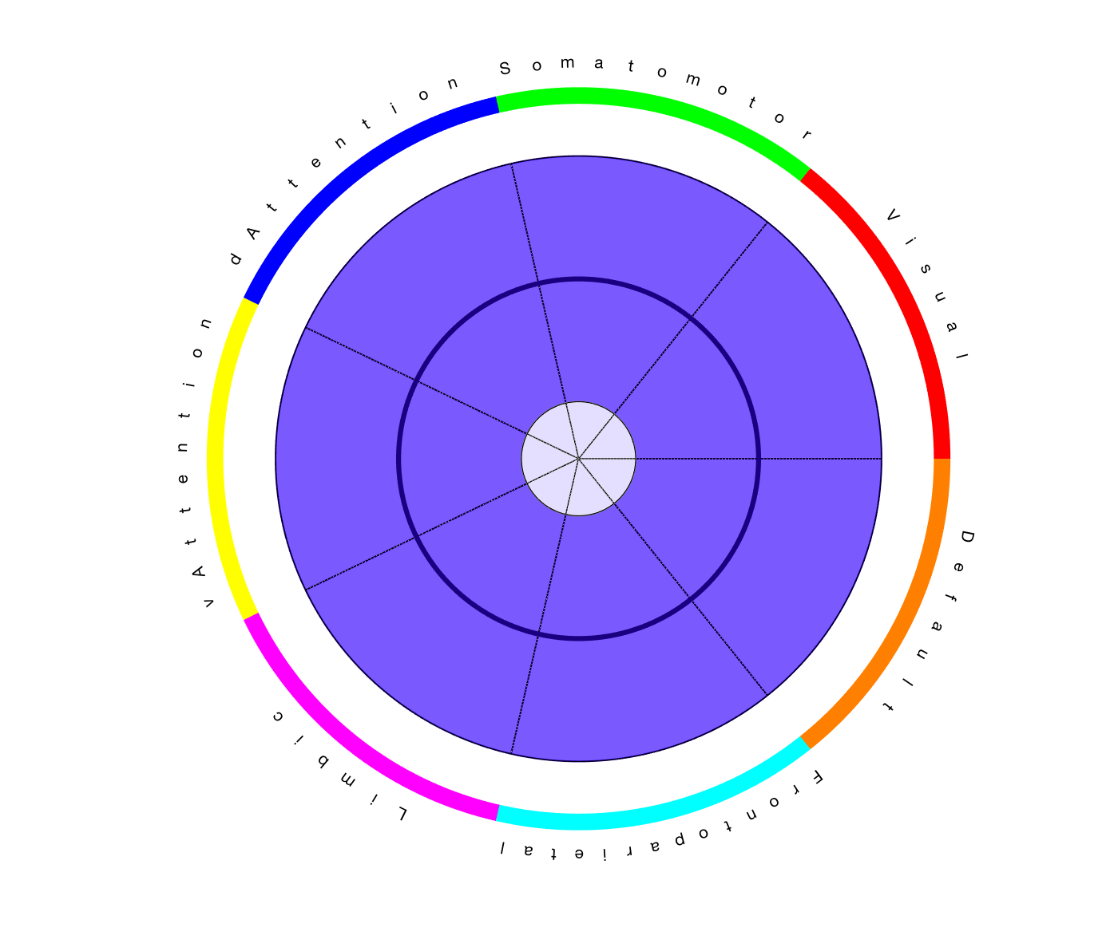
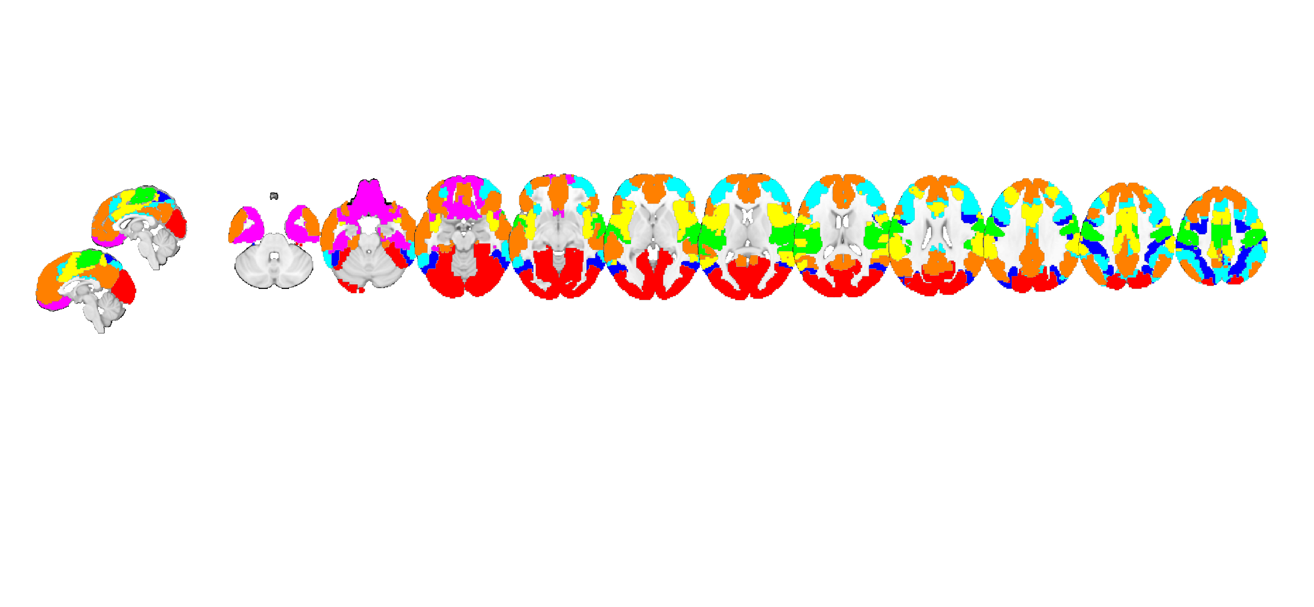
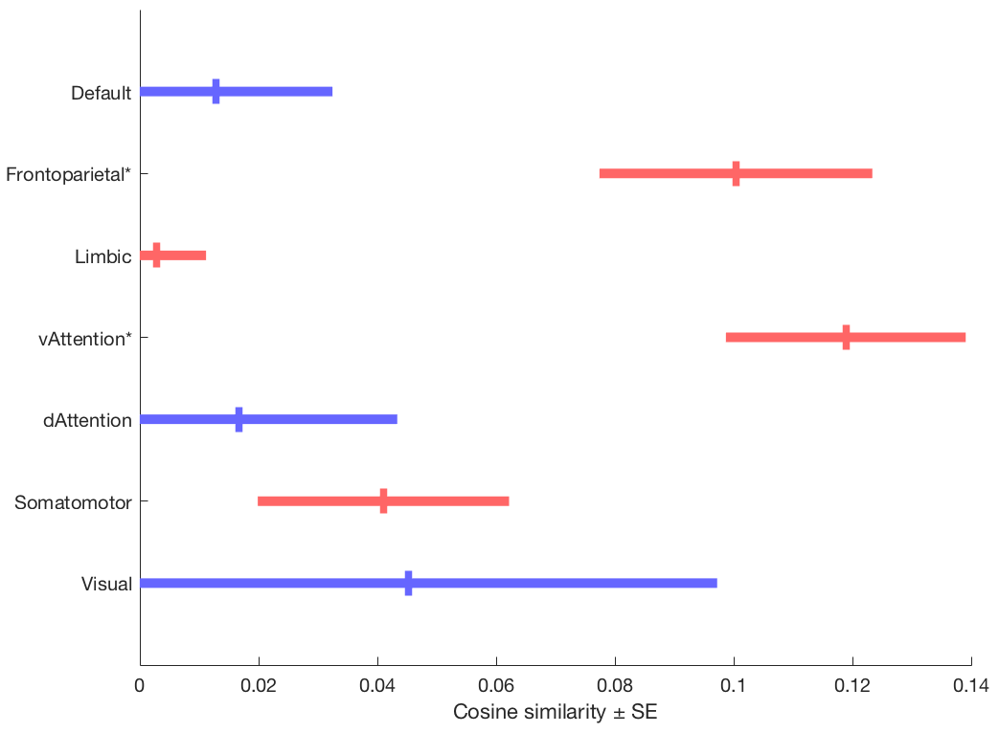
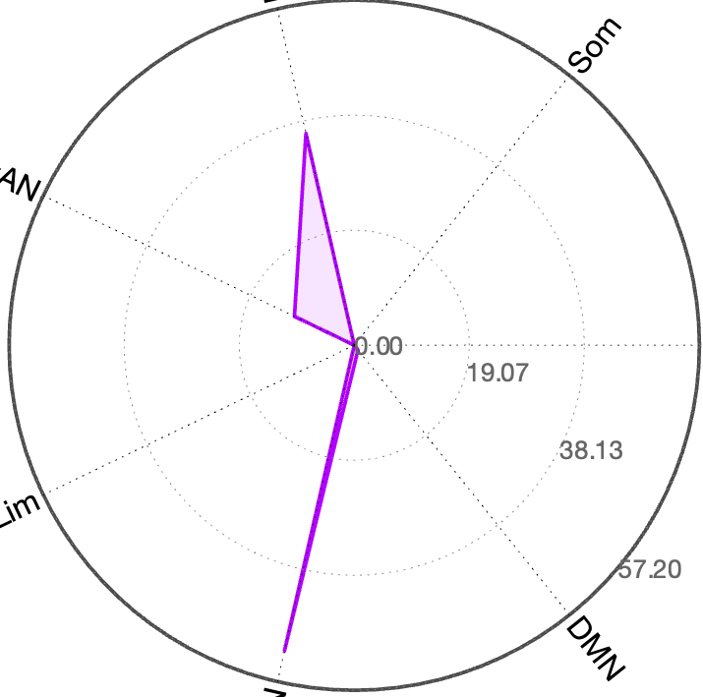
dAttn
SomMot
SomMot
dAttn
Vis
Vis
vAttn
vAttn
Cortical Networks
Wedge plot version
DMN
DMN
Limbic
Limbic
FPN
FPN
dAttn
SomMot
vAttn
Polar plot version
Vis
Cortical Networks
Limbic
DMN
FPN

Slide 2
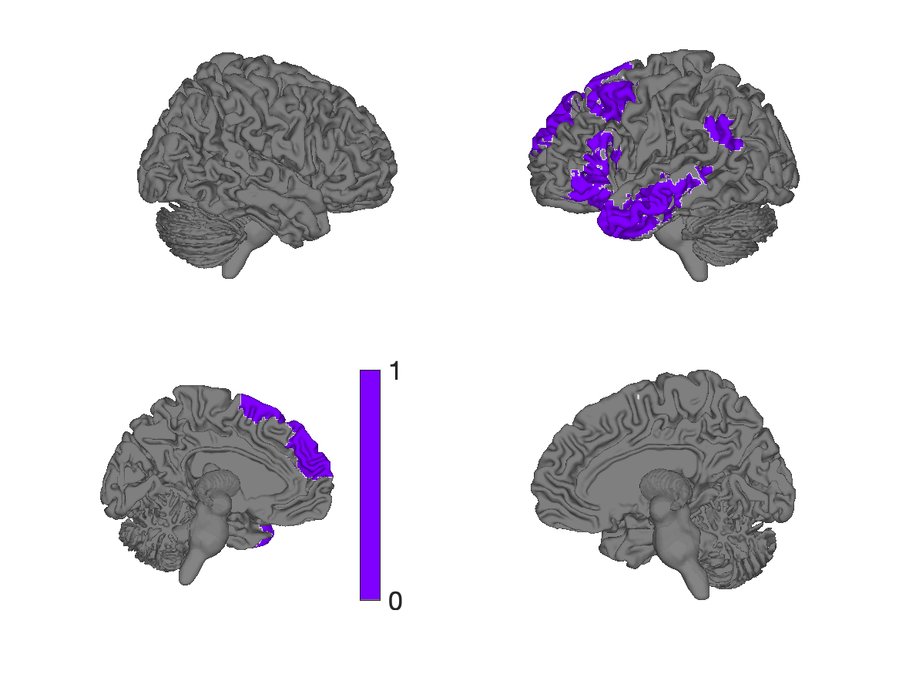
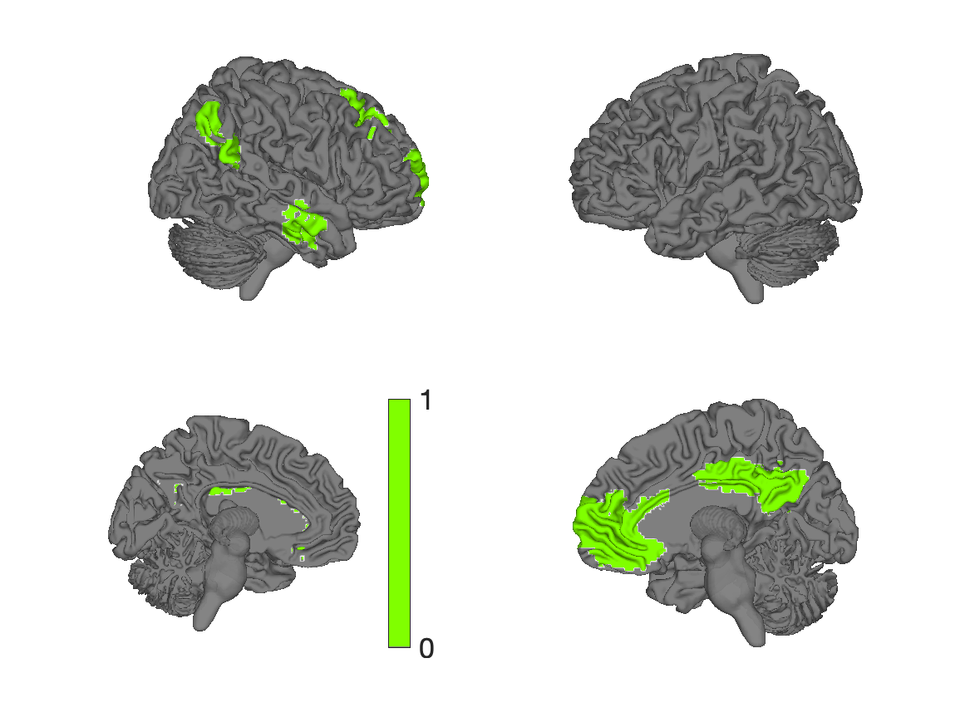
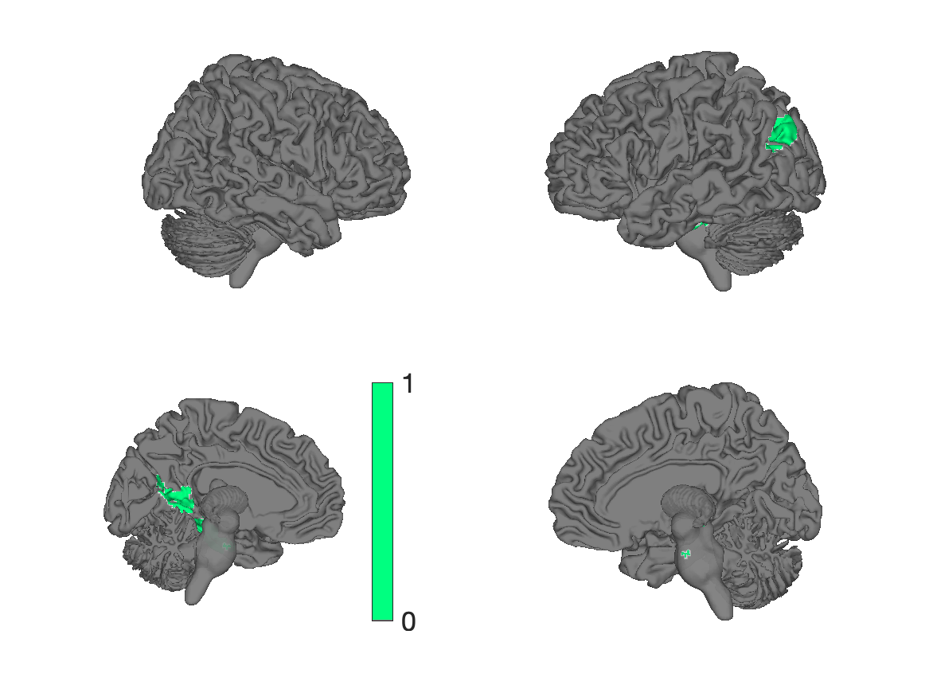
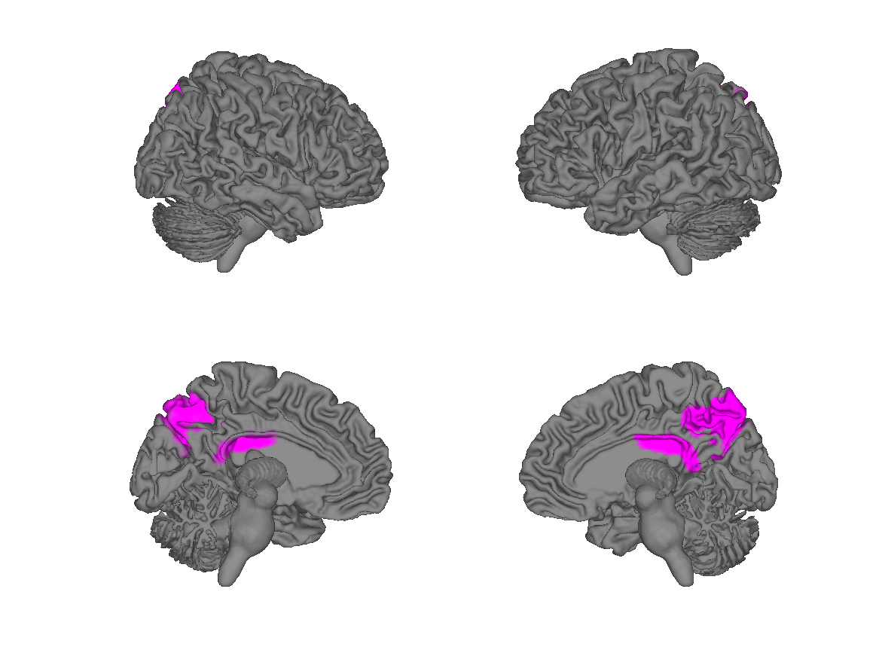
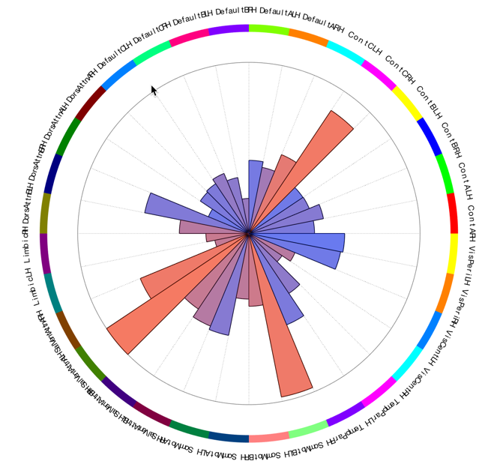
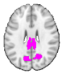
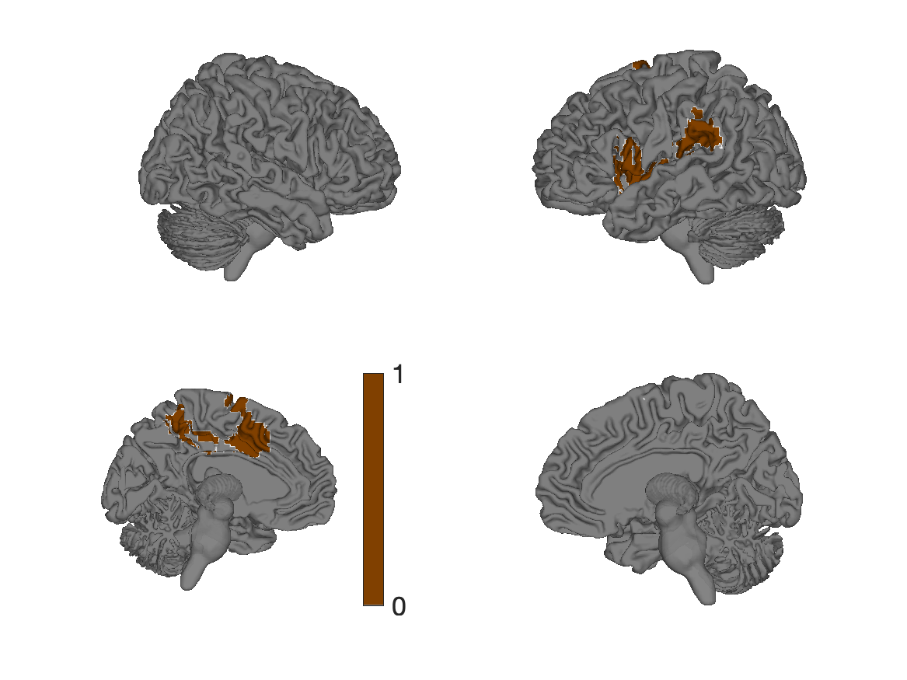
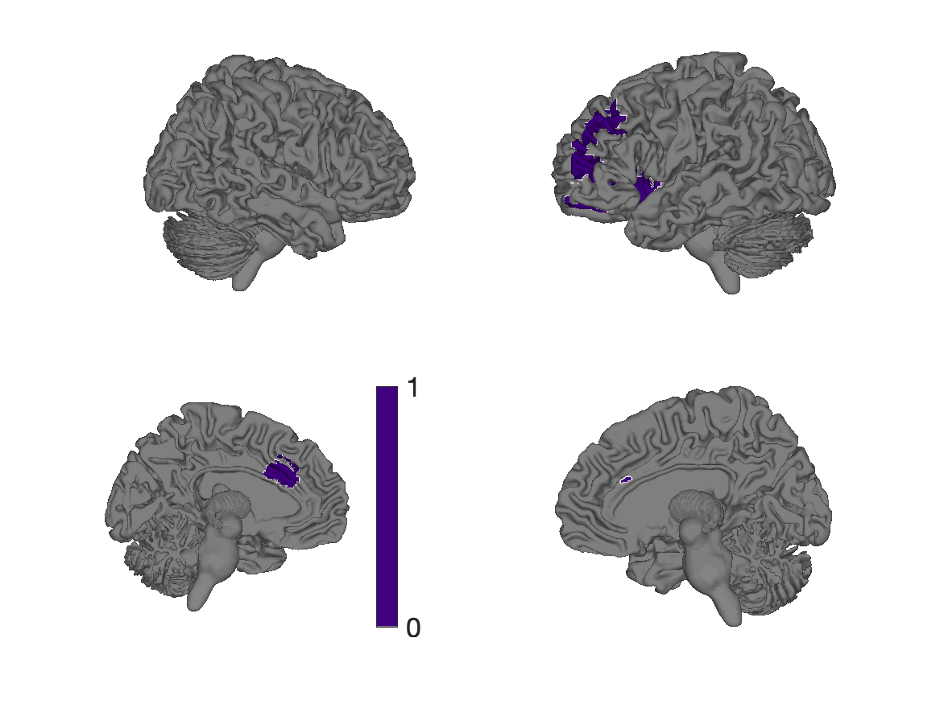
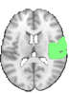
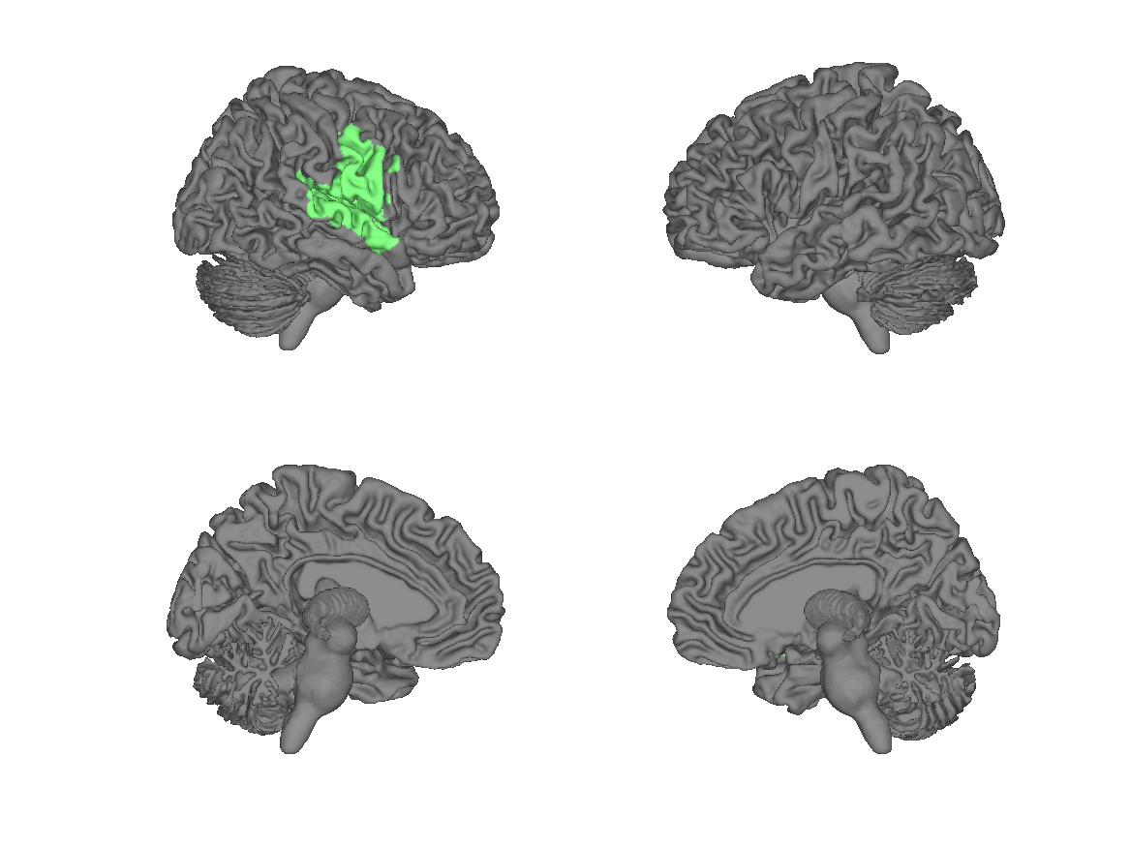
Yeo 17 networks R/L
Default C
Default B
R
L
R
L
Control C
L
R
R
L
dAttn B
Default A
Control B
R
R
L
L
Control C
R
R
dAttn A
Control A
L
L
R
R
Limbic
L
VisPeri B
L
R
R
vAttn A
L
L
VisCent A
R
SomMotor B
R
L
R
L
vAttn B
L
TempPar
R
SomMotor A
L
vAttn A
SomMotor B

Slide 3
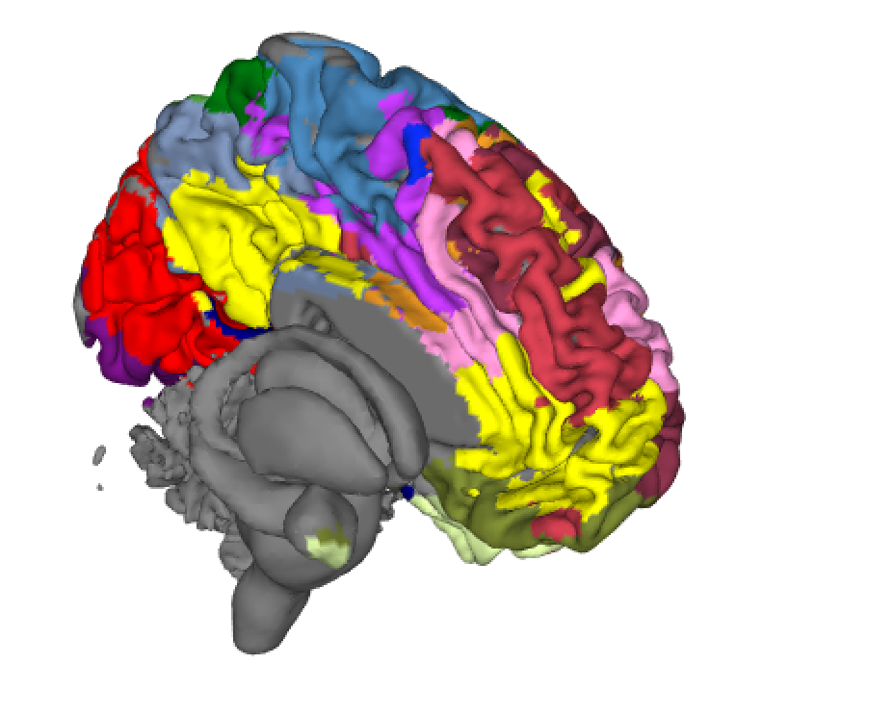
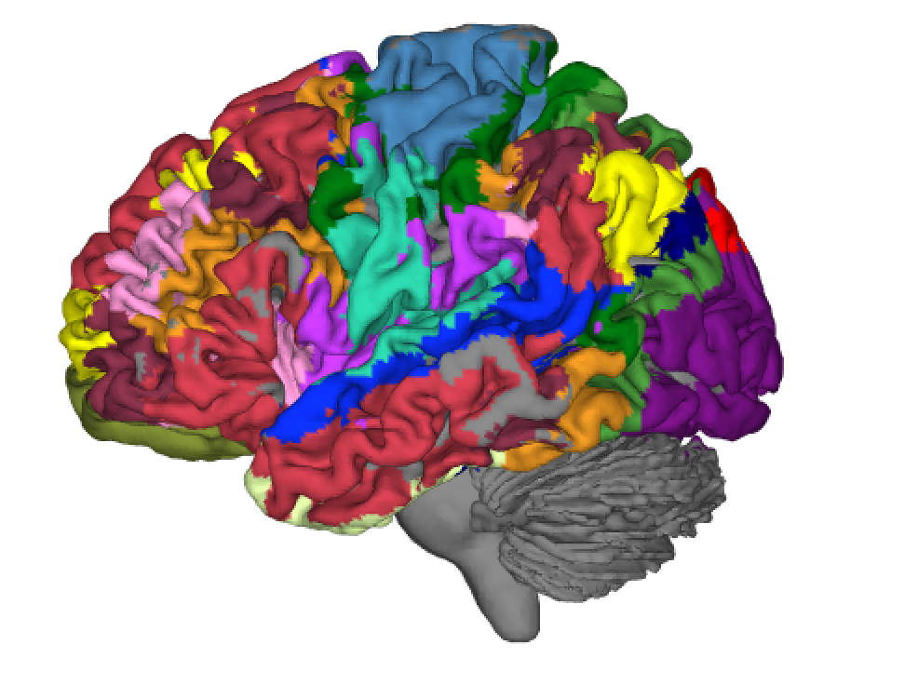
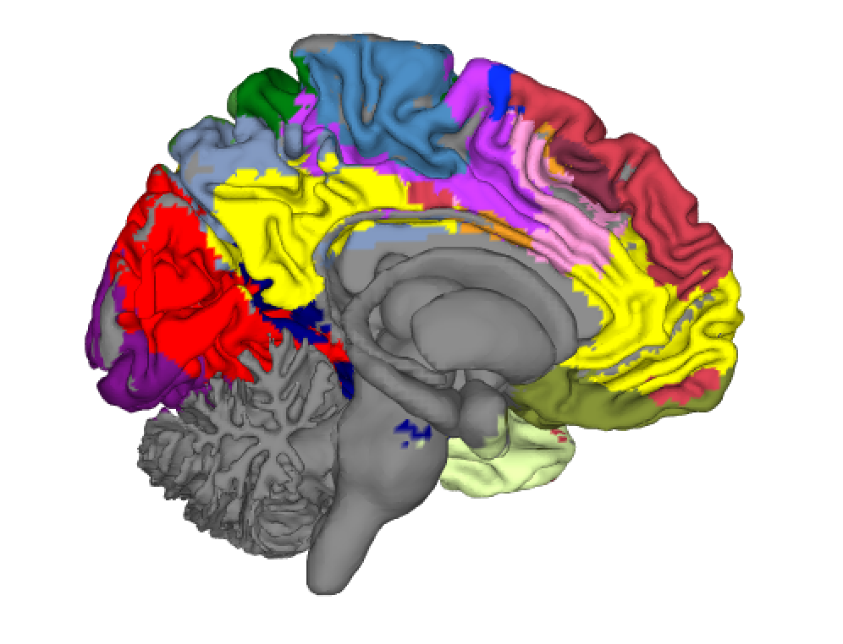
Figure 5
a
c
Networks from 1,000-person functional connectivity
d
e
b
Correlation
Time
Yeo 17 networks

Slide 4
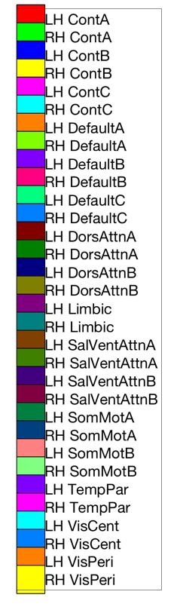
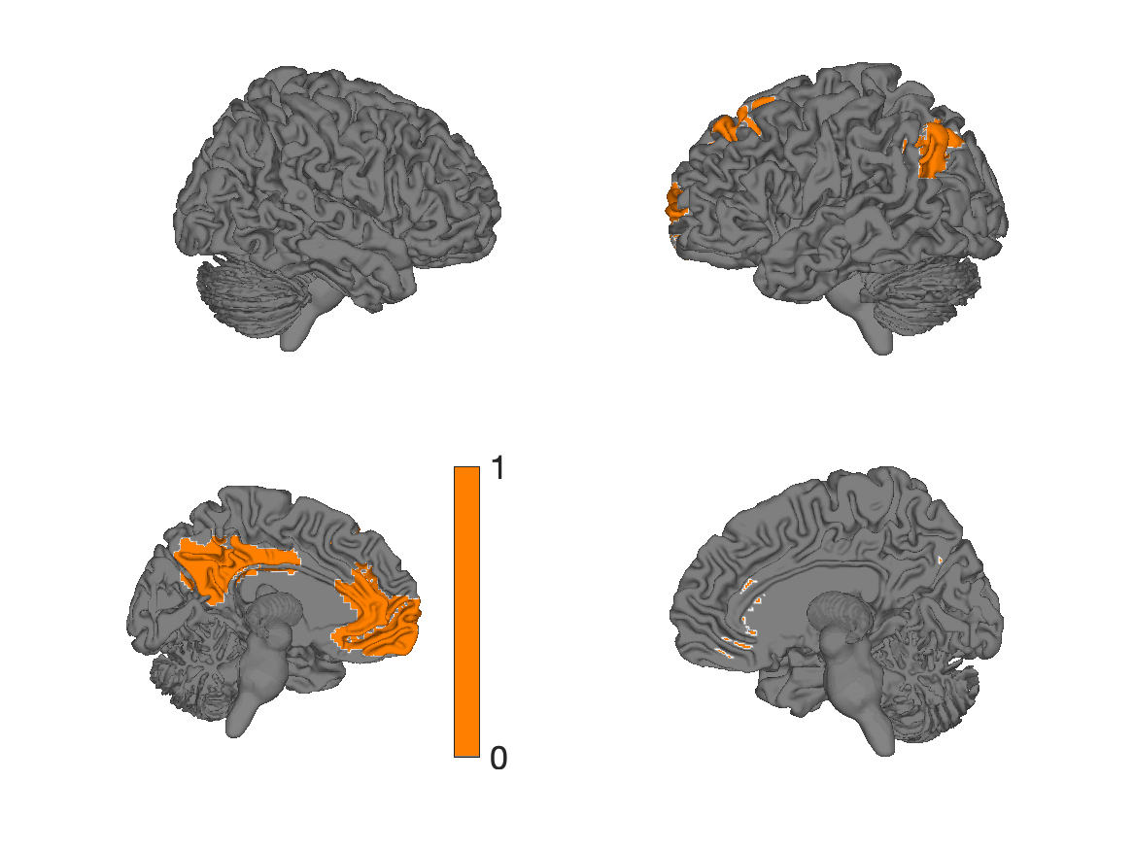
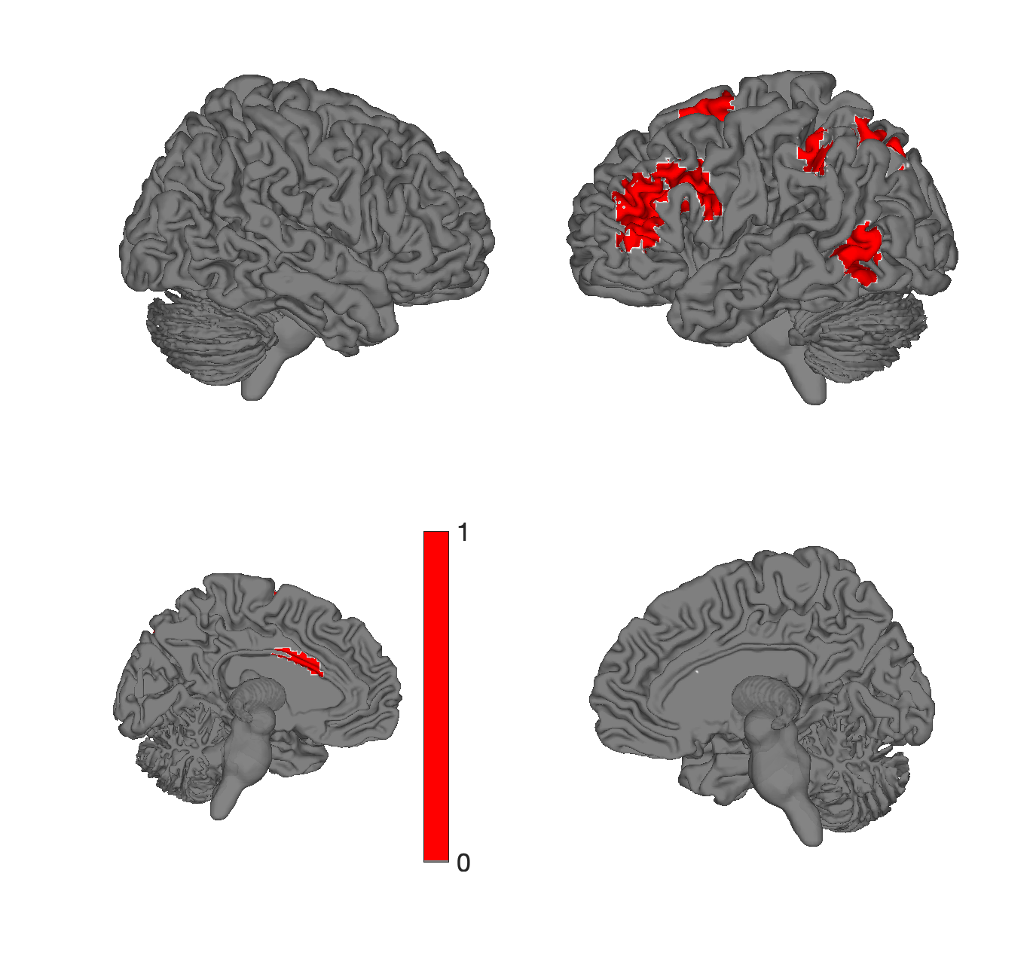
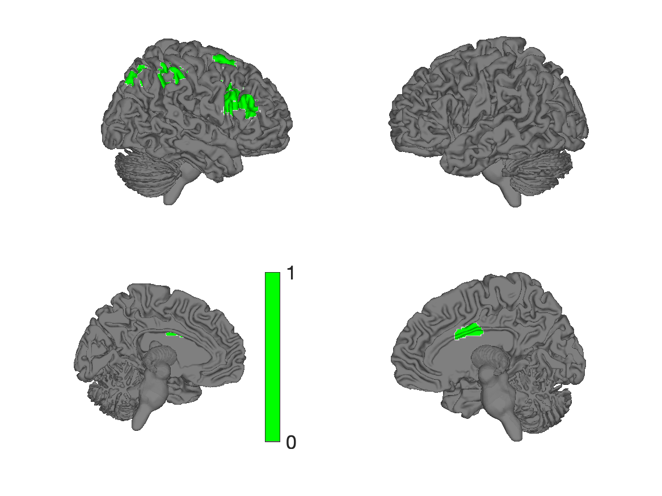
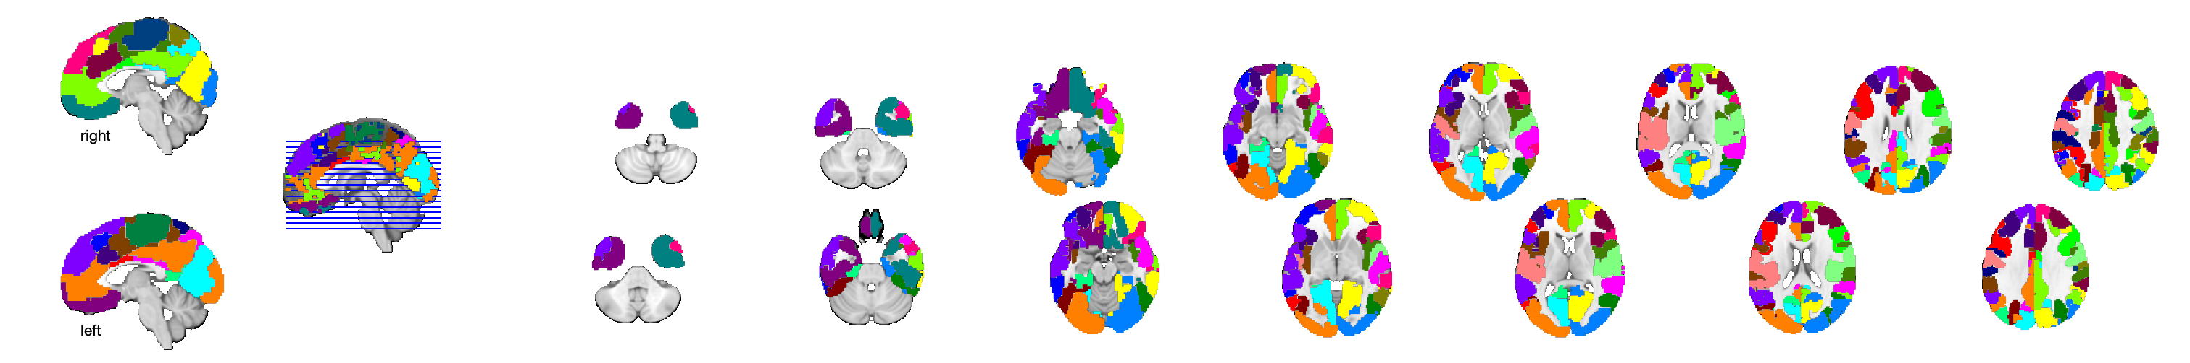
Yeo 17 networks R/L
Default C
Default A
Default B
R
L
R
L
Control C
L
R
R
L
dAttn B
Default A
Control B
R
R
L
L
Control A
R
R
dAttn A
Control A
L
L
R
R
Limbic
L
VisPeri B
L
R
R
vAttn A
L
L
VisCent A
R
SomMotor B
R
L
R
L
vAttn B
L
TempPar
R
SomMotor A
L

Slide 5
Yeo 17 networks R/L
Default C
Default B
L
R
L
R
Control C
R
L
L
R
dAttn B
Default A
Control B
L
L
R
R
L
L
dAttn A
Control A
R
R
L
L
Limbic
R
VisPeri B
R
L
L
vAttn A
R
R
VisCent A
L
SomMotor B
L
R
L
R
vAttn B
R
TempPar
L
SomMotor A
R
Notes:
atl = load_atlas('yeo17networks');
colorband_colors = scn_standard_colors(num_regions(atl));
for i = 29:32 % 1:length(atl.labels)
atl_subset = select_atlas_subset(atl, i);
sh = surface(atl_subset, 'color', colorband_colors{i}, 'foursurfaces');
drawnow
saveas(gcf, ['yeo17networks_4surf' num2str(i) '.png']);
close
sh = surface(atl_subset, 'color', colorband_colors{i});
drawnow
saveas(gcf, ['yeo17networks_cutaway' num2str(i) '.png']);
close
end
diary('network_labels_1-17.txt');
char(atl.labels{:})
diary off
montage(atlas_obj, 'colors', colorband_colors);

Slide 6
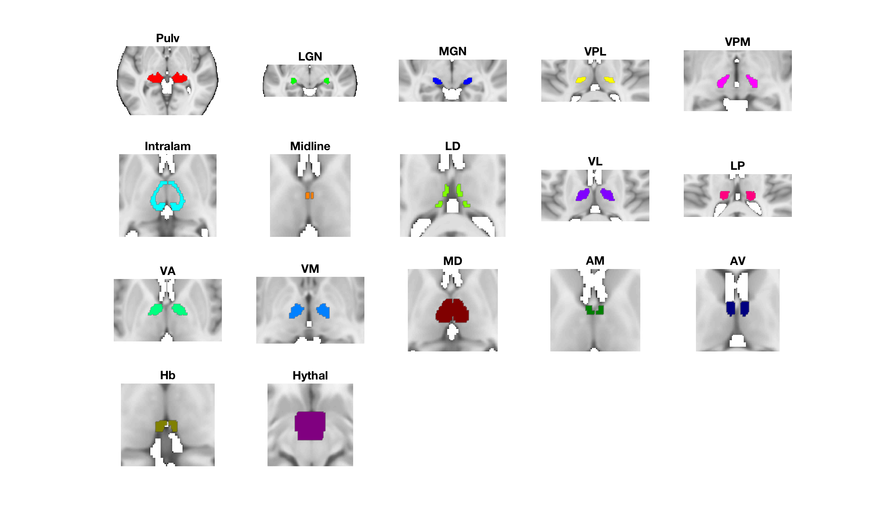
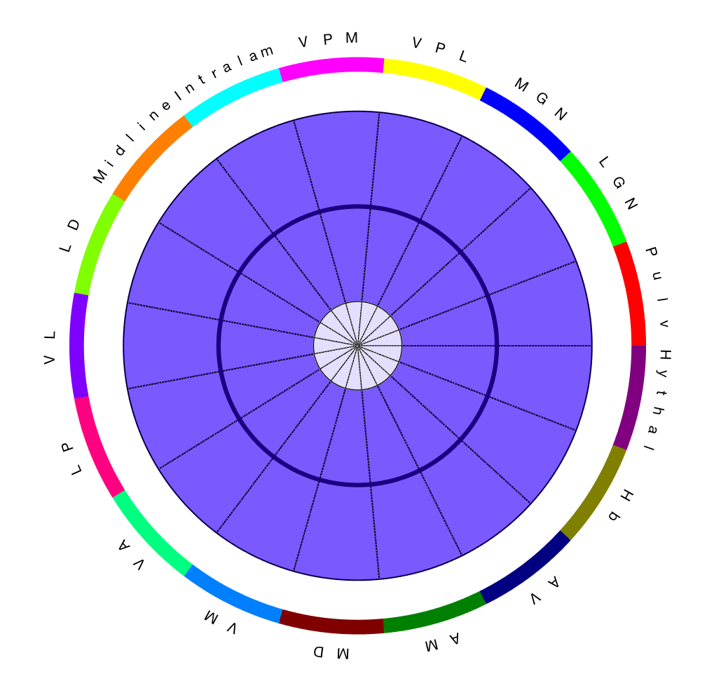
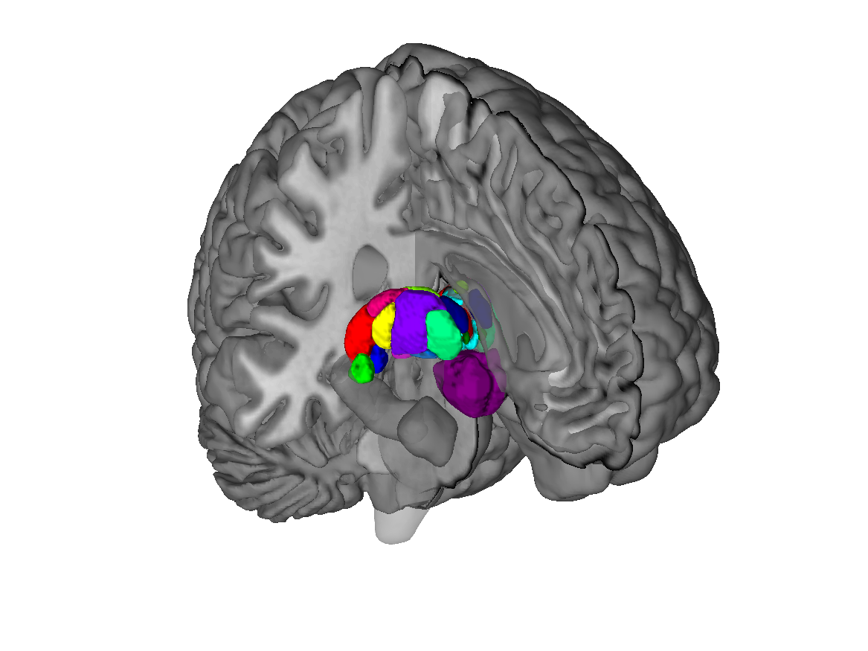
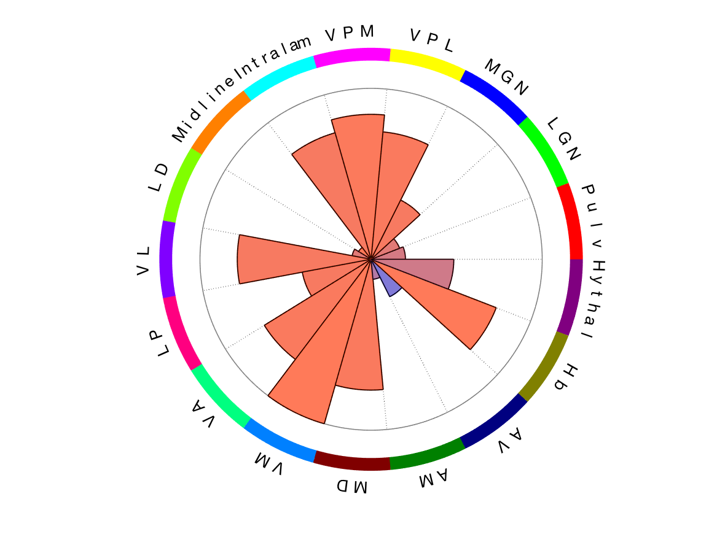
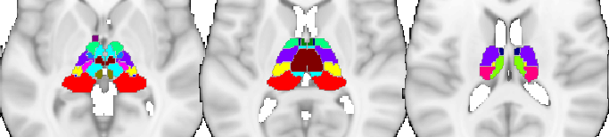
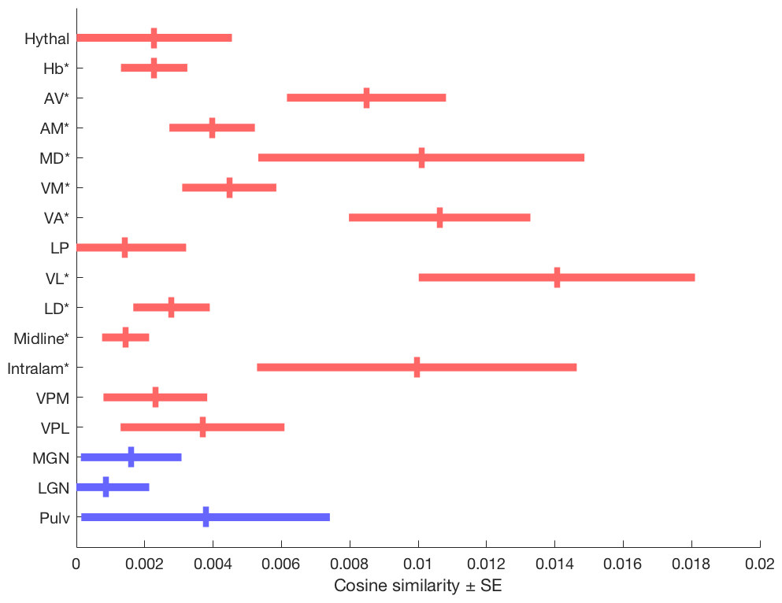
B
Thalamic regions
Thalamic regions
Thalamus

Slide 7
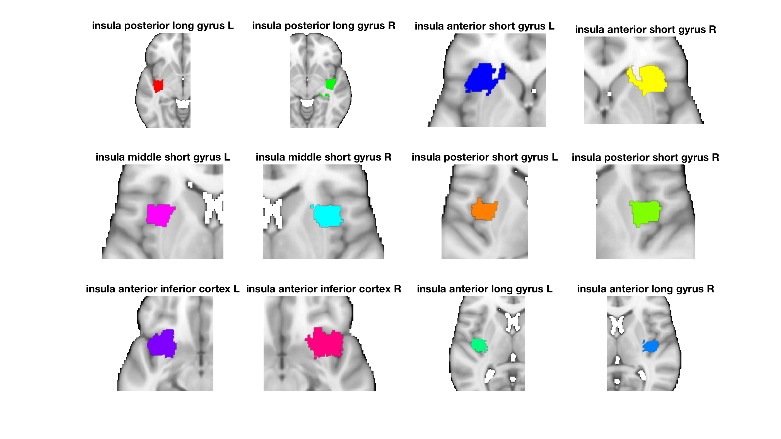
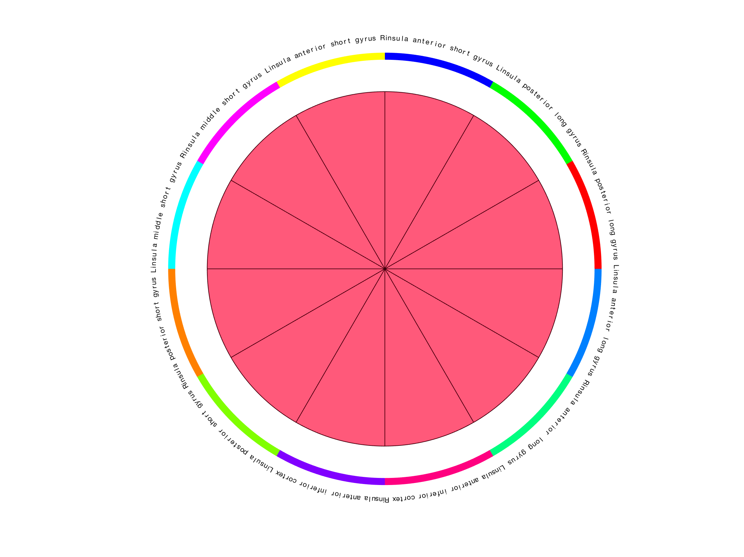
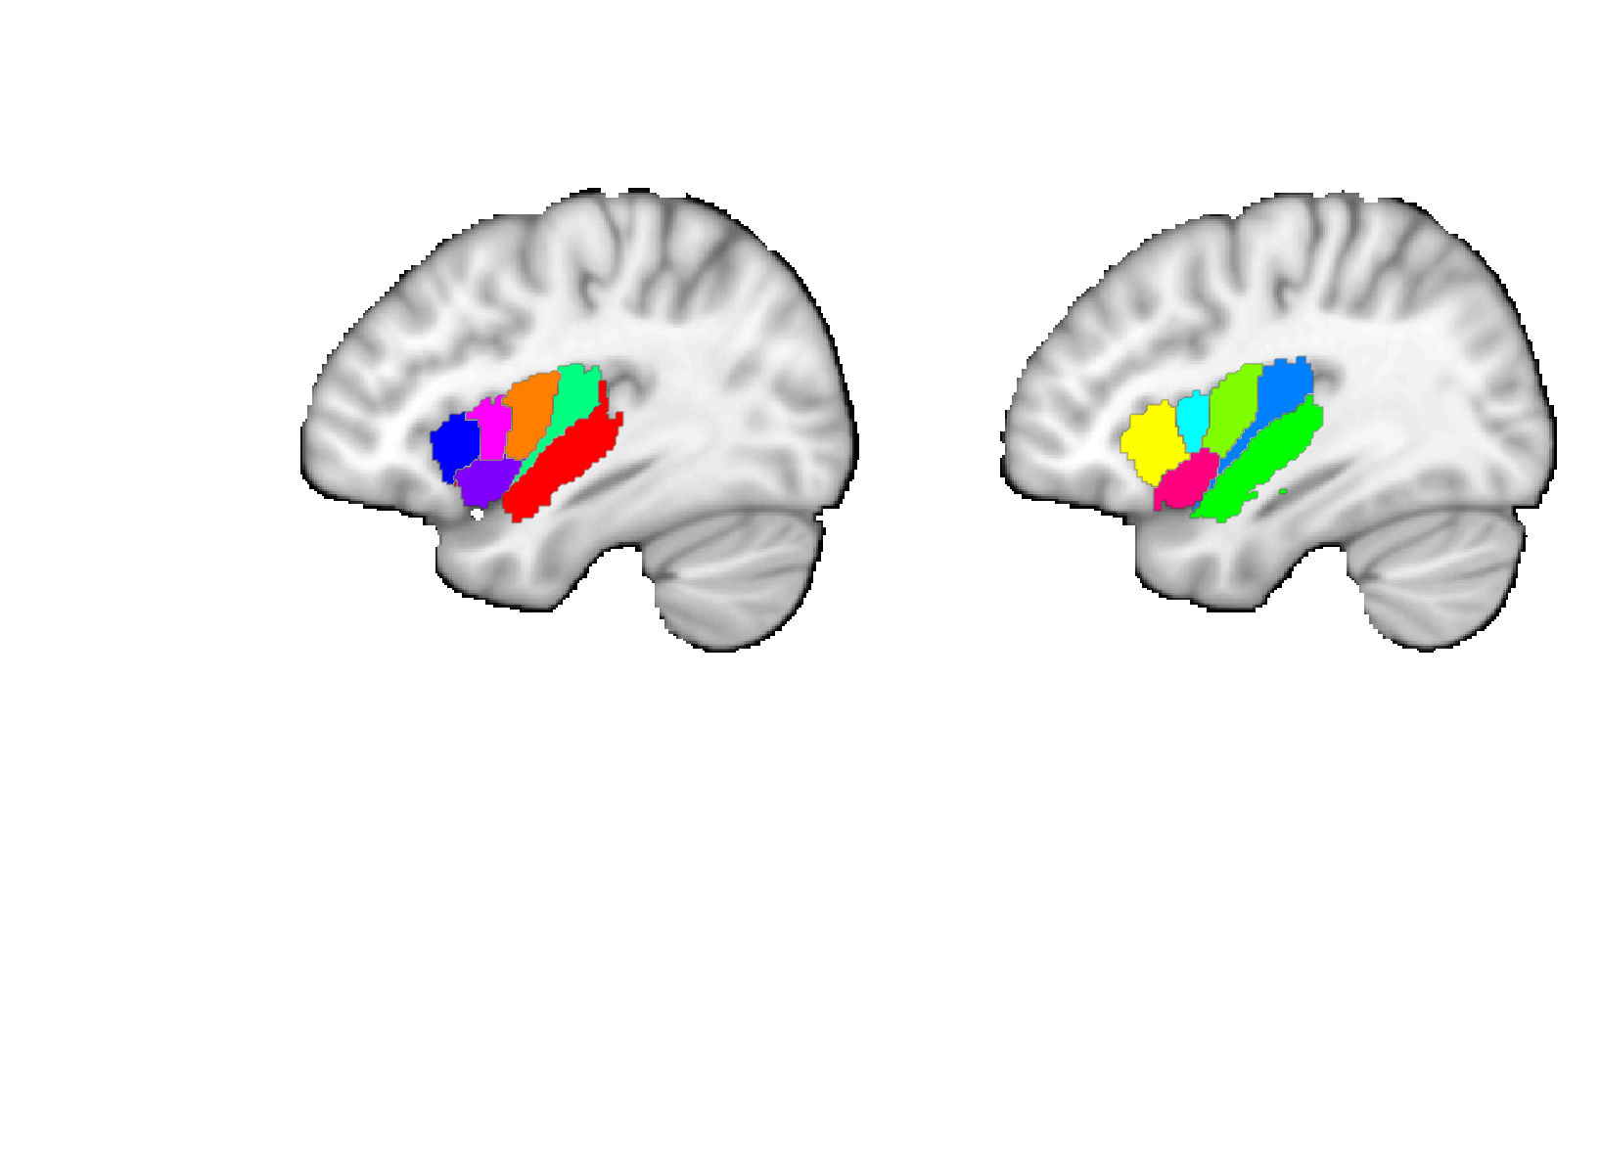
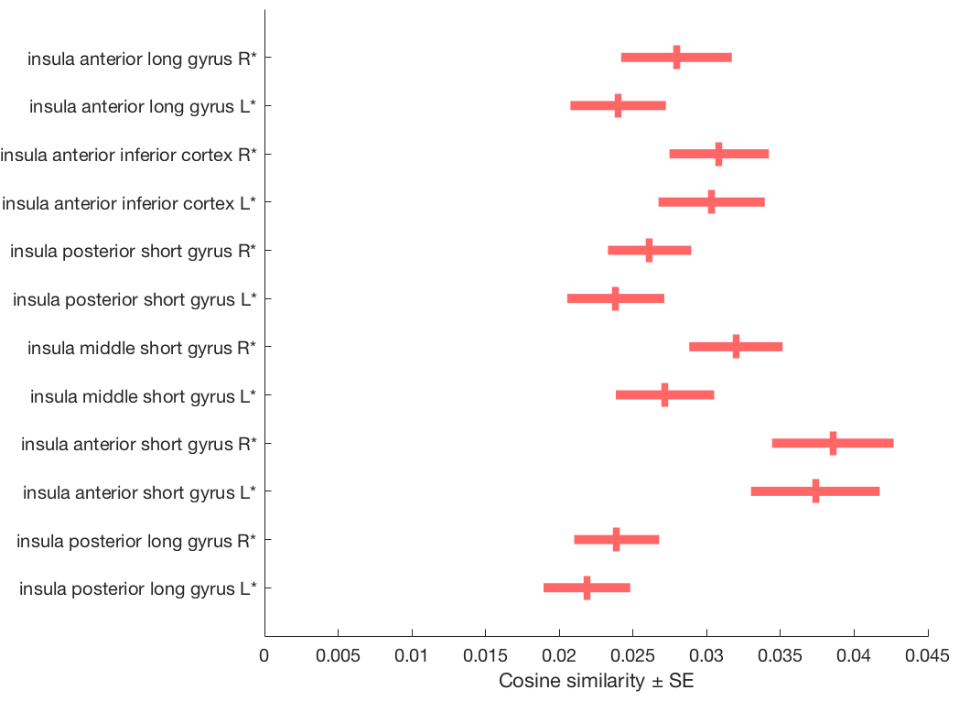
Faillenot insula
Post. short
Ant. long
Short
Long
Post.
Ant.
Middle short
Post. long
Mid.
Post.
Ant. short
Ant.
Ant. inf.
L
Ant. inferior
R
L
R
Short
Long
Post.
Ant.
Mid.
Post.
Ant.
Insula
Ant. inf.

Slide 8
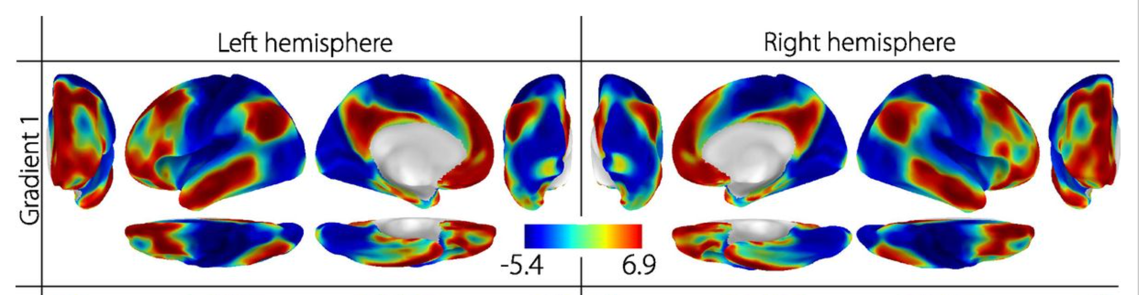
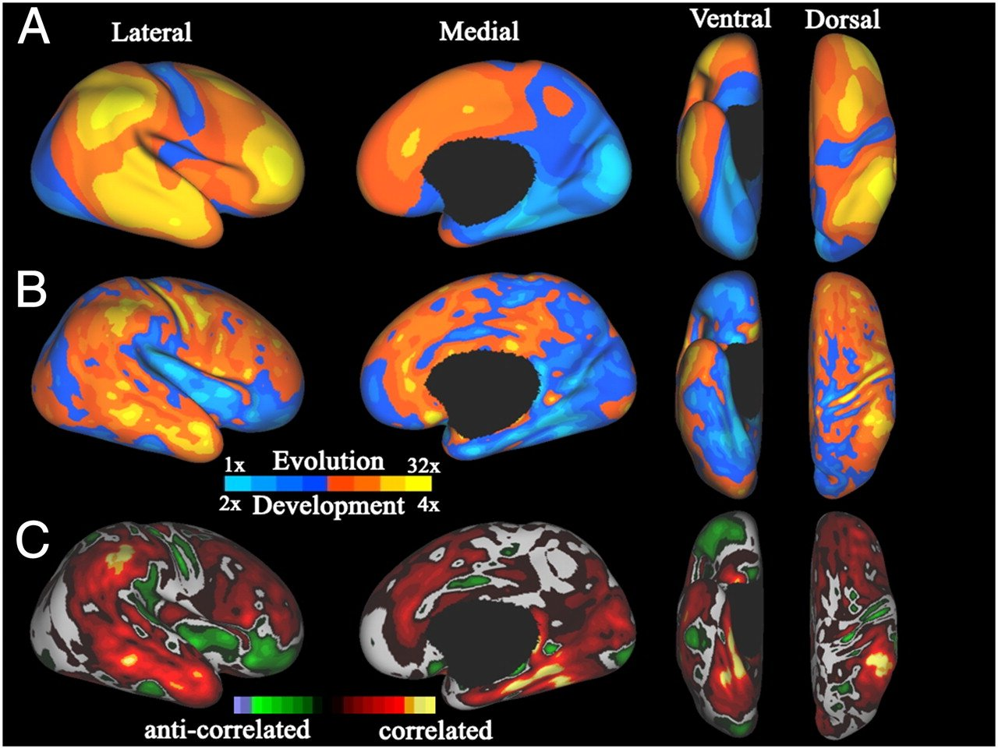
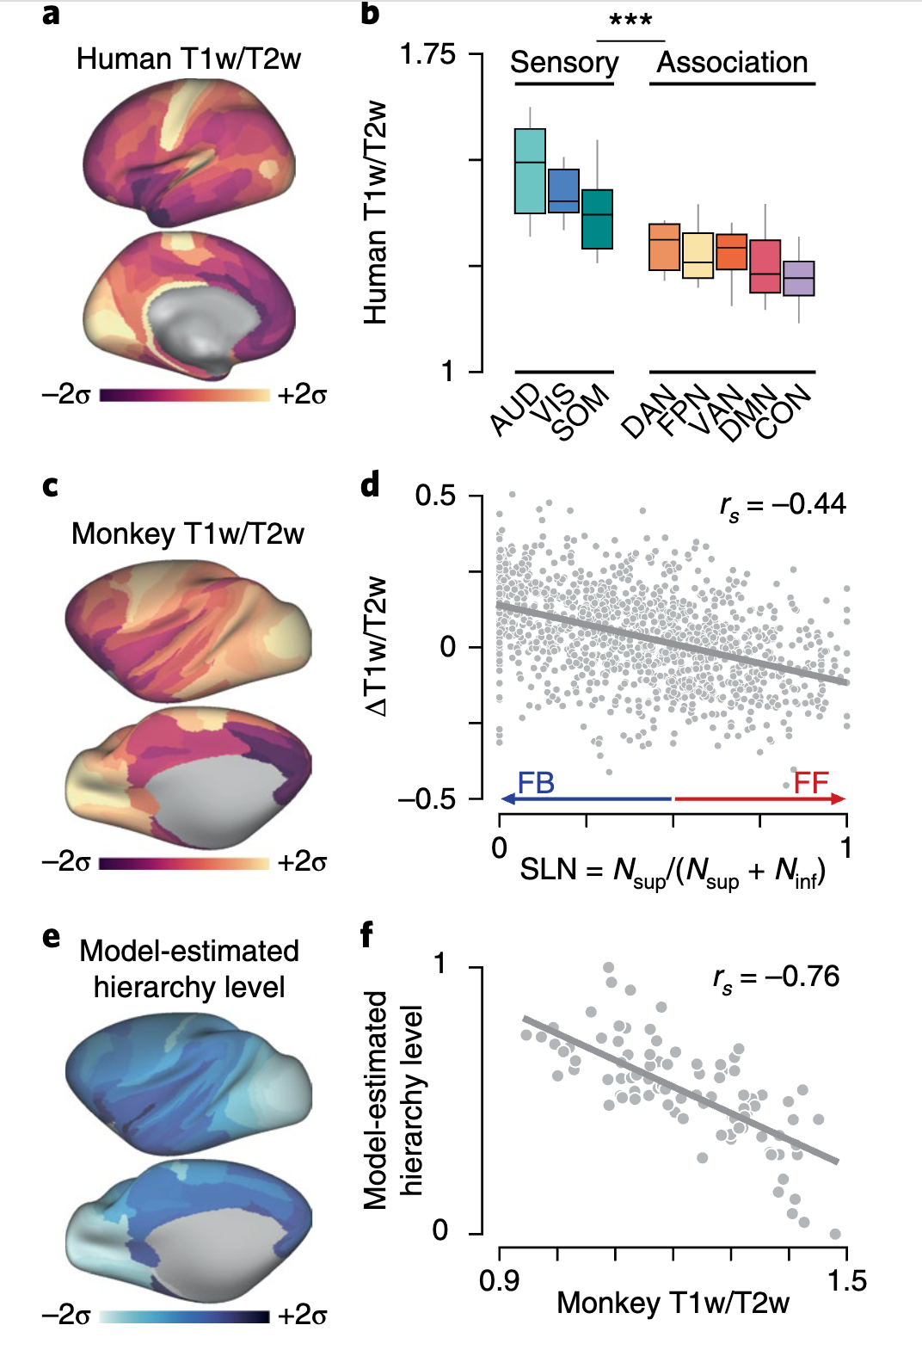
A principle of cortical organization
Gradient: Unimodal to multimodal (integrative)
Expansion from macaque to human
Expansion during development
Macaque cortical hierarchy: Low to High
Margulies 2016; Hill 2010; Burt 2018
Notes:
Macaque is left-right flipped

Slide 9
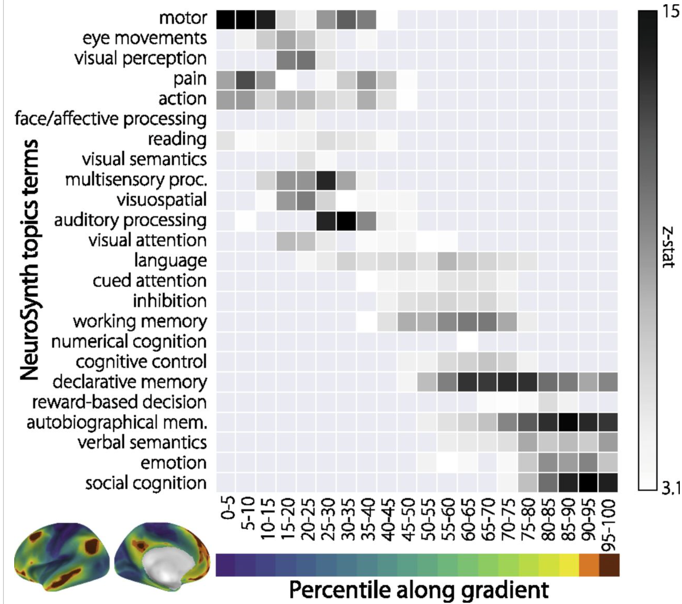
Principal gradient
Gradient: Unimodal to transmodal
Margulies 2016
Notes:
Macaque is left-right flipped

Slide 10
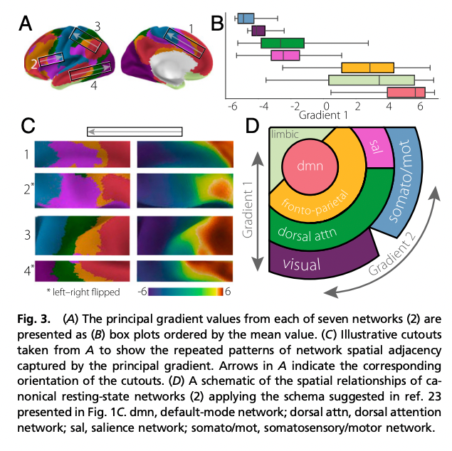
Margulies gradients mapped to Yeo networks
Gradient: Unimodal to transmodal
Margulies 2016
Notes:
Macaque is left-right flipped

Slide 11
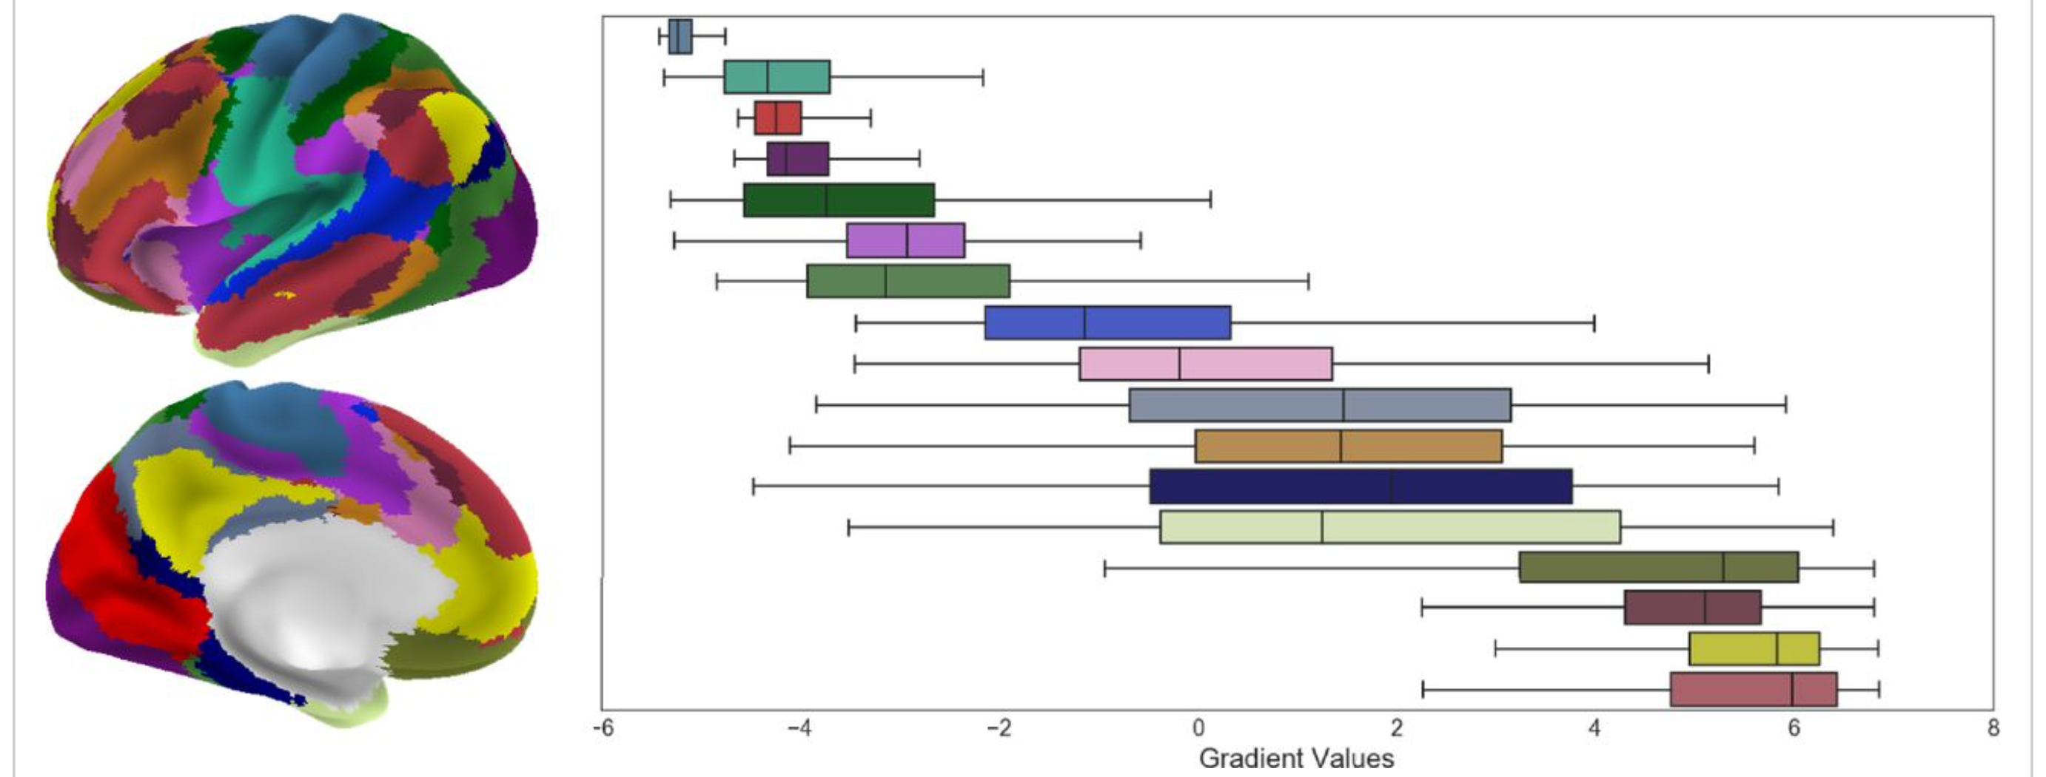
Margulies gradients mapped to Schafer networks
Note: missing ref for this figure here…
Need to find source
Gradient: Unimodal to multimodal
FPN-A
DMN-A
DMN-B
Margulies 2016; Hill 2010; Burt 2018
Notes:
Macaque is left-right flipped

Slide 12
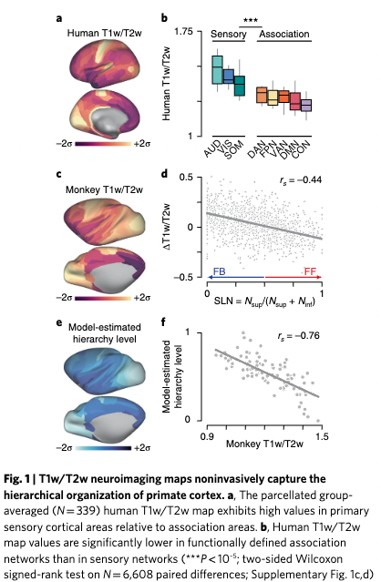
Myelination as a proxy for cortical hierarchy – Burt 2018 Nat Neuro
T1/T2 ratio is a proxy for myelin content
The lower the myelin content, the higher the estimated level of cortical hierarchy in macaques
Default mode (DMN) and cingulo-opercular (CON) network have the lowest T1/T2 and are thus at the “top” of the hierarchy.
Hierarchies are estimated from macaque anatomical projections, with supragranular layers 2/3 mainly with feedforward projections and infragranular layers 5/6 mainly with diffuse feedback projections:
Markov/Kennedy JCompAnat 2013
https://onlinelibrary.wiley.com/doi/full/10.1002/cne.23458
Other insights:
CON is being relabeled in 2024 by Dosenbach’s group as a somato-visceral action network (after Gordon 2024 Nature paper)
Regions with higher myelin content tend to be more unimodal (vs. transmodal)

Slide 13
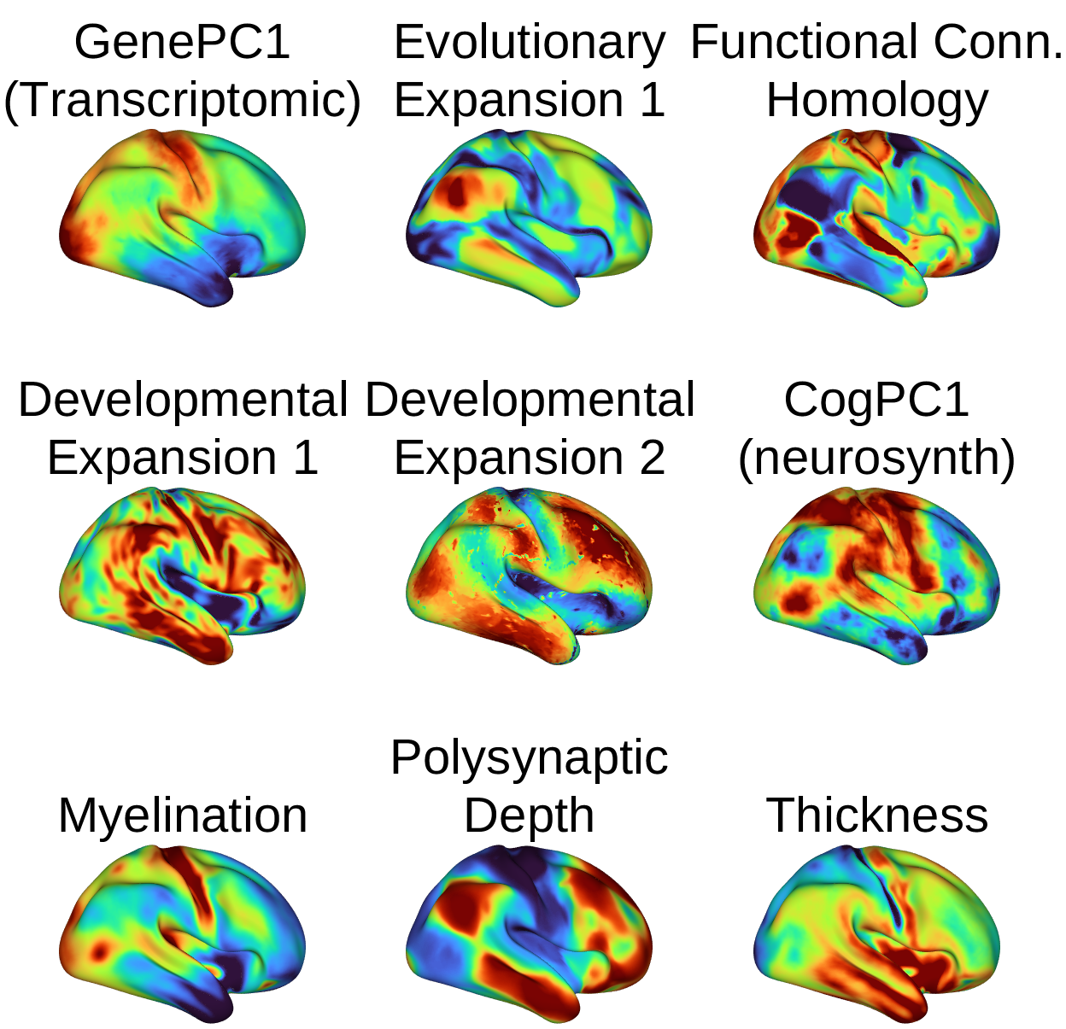

Slide 14
aINS
dACC
Notes:
load('/Users/f003vz1/Documents/GitHub/Neuroimaging_Pattern_Masks/neurosynth/neurosynth_data_obj.mat')
m = mean(neurosynth_data);
create_figure('overall p activation montage'); axis off;
o2 = montage(m);
% Mean across 27072 contrast maps with diverse functional tasks, from Neurosynth.org, downloaded April 2022 (latest version)

Slide 15
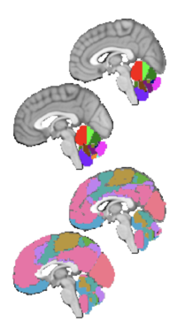
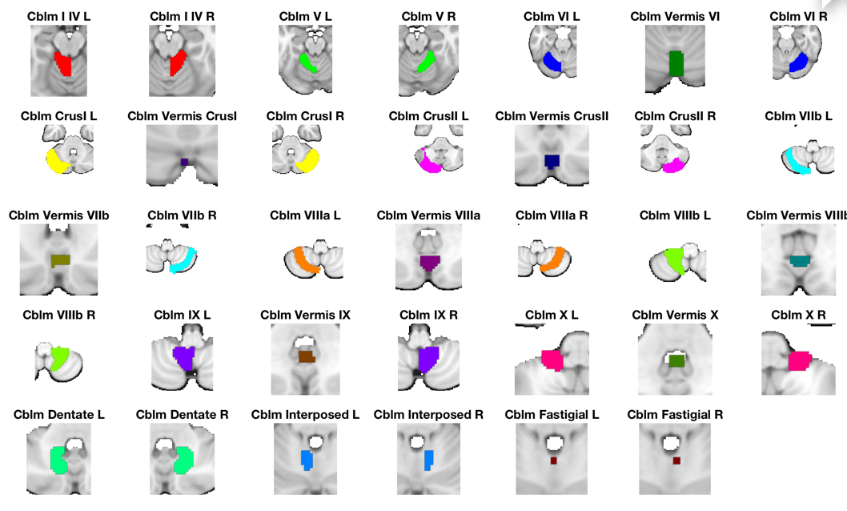
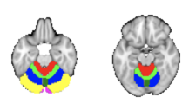
Diedrichsen Cerebellum
Diedrichsen, Jörn, Joshua H. Balsters, Jonathan Flavell, Emma Cussans, and Narender Ramnani. 2009. A Probabilistic MR Atlas of the Human Cerebellum. NeuroImage 46 (1): 39?46.’
Choi, Eun Young, B. T. Thomas Yeo, and Randy L. Buckner. 2012. “The Organization of the Human Striatum Estimated by Intrinsic Functional Connectivity.” Journal of Neurophysiology 108 (8): 2242–63.
Buckner, Randy L. 2013. “The Cerebellum and Cognitive Function: 25 Years of Insight from Anatomy and Neuroimaging.” Neuron 80 (3): 807–15.

Slide 16
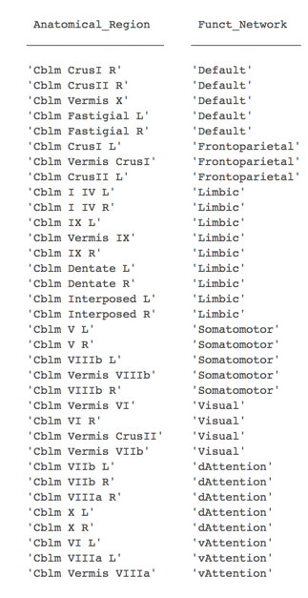
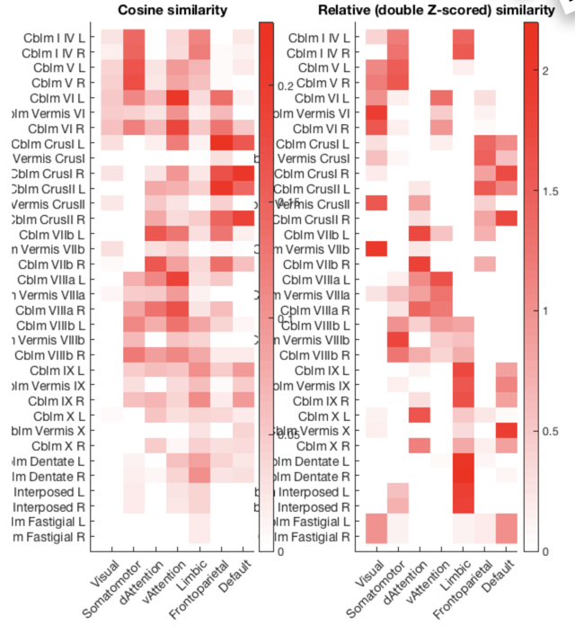
Cerebellum
Buckner/Yeo

